Slide 1
Welcome to CS10 Group Second Meeting
Team member
Wilma Liu
Fiona Hu
Pat Zhang
Elvia Tong
Reehaa Ding
William Quan

Slide 2












Project structure
Problem identification
Support identification
Support recommendation
(Machine learning)
Problem Data Analysis
Support data analysis

Slide 3

We are here this week
Problem identification
Support identification
Support recommendation
(Machine learning)
Problem Data Analysis
Support data analysis

Slide 4
How we identify the problems
By showing the impact of the COVID-19 to different departments and economy
Cases impact：
Cases have been consistently increased since 2020
COVID-19 timeline info
COVID-19 response, recovery and impact
Economy impact：
Economy’s downturn since 2020
Economy trend from 2020 to 2023
COVID-19 response, recovery and impact

Slide 5
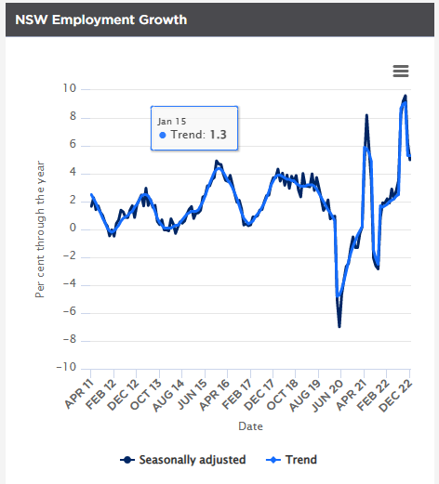
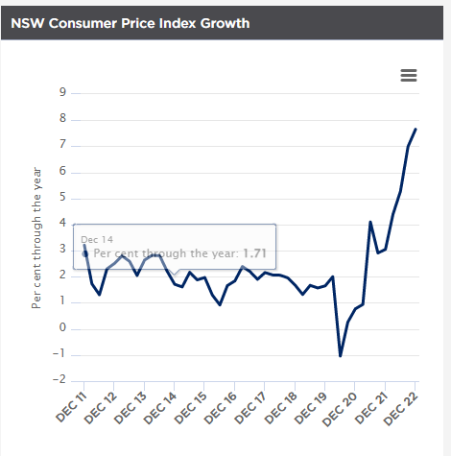
Problem data analysis- data collection
Cases
Collect COVID-19 data
Cases by locations and postcodes
Cases by age groups
Economy
Refer to the NSW treasury

Slide 6

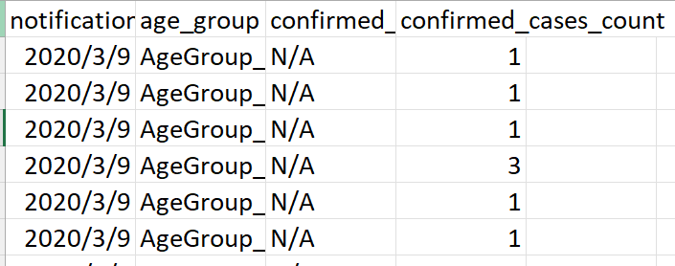
Problem data analysis- data collection
Cases by locations and postcodes
Cases by age groups

Slide 7
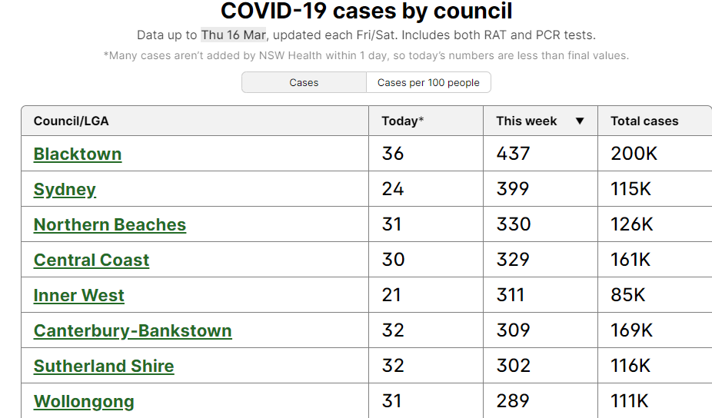
Problem data analysis- data collection

Slide 8
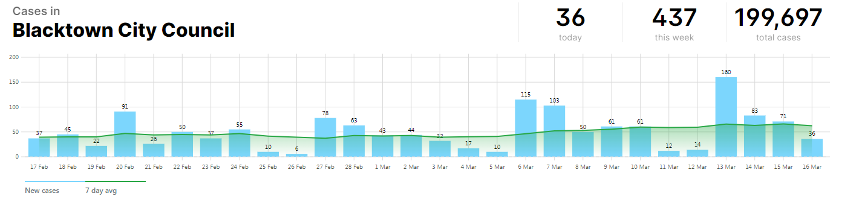
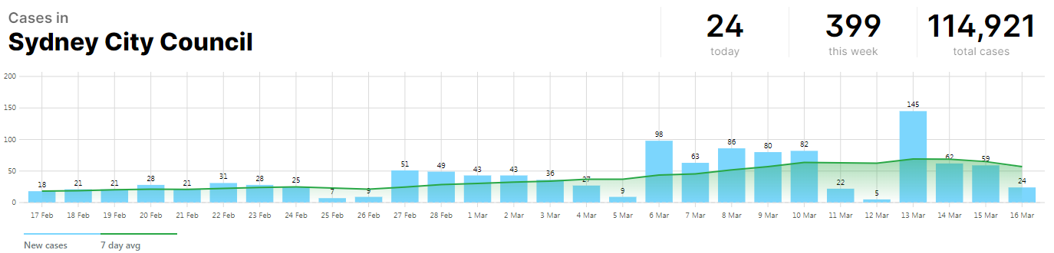
Problem data analysis- data collection

Slide 9
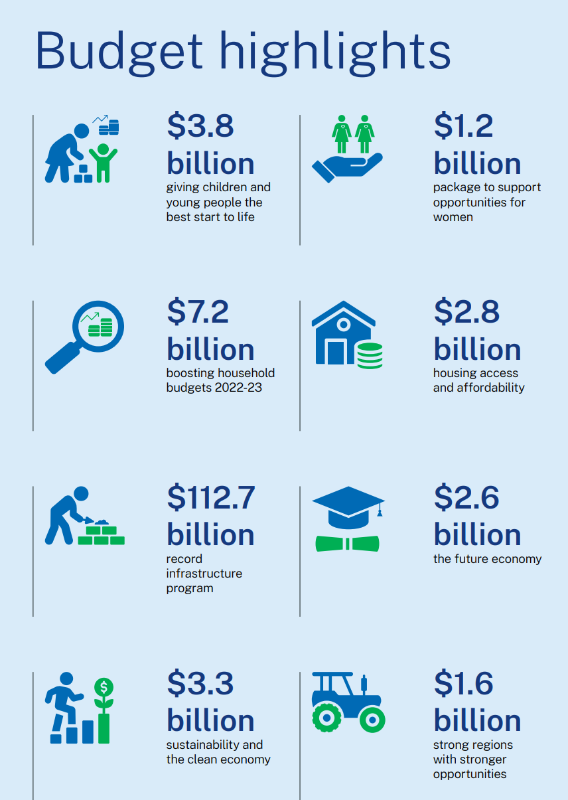

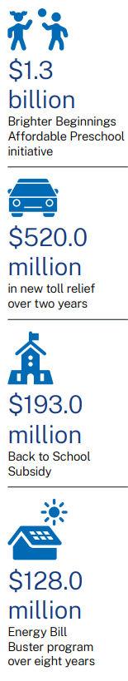
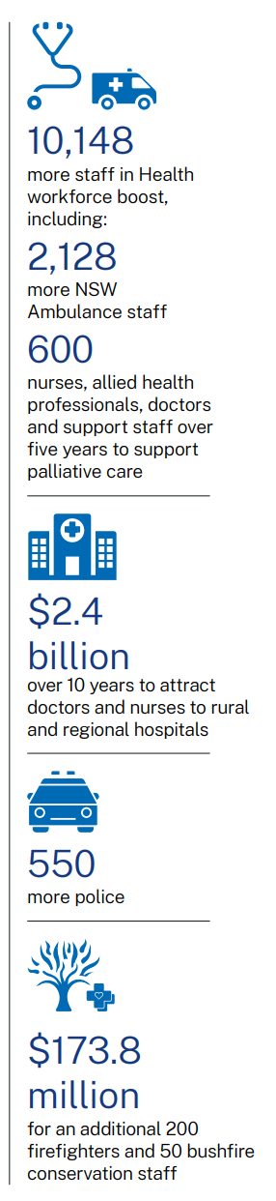
Money support by NSW government
Supporting families

Slide 10
Problem

Slide 11
Thank you !!!

